Slide 1
Golf Merit Badge Option 1 Traditional Golf
Troop 344/9344
Pemberville, OH

Slide 2
Golf Merit Badge Requirements
Discuss safety on the golf course. Show that you know first aid for injuries or illnesses that could occur while golfing, including lightning, heat reactions, dehydration, blisters, sprains, and strains.
Complete Option 1: Traditional Golf
Study the USGA Rules of Golf now in use.
Tell about the three categories of golf etiquette.
Show that you know about the definitions of golf terms.
Show that you understand the "Rules of Amateur Status."

Slide 3
Golf Merit Badge Requirements
Tell about your understanding of the World Handicap System.
Do the following:
Tell about the early history of golf.
Describe its early years in the United States.
Tell about the accomplishments of a top golfer of your choice.

Slide 4
Golf Merit Badge Requirements
Do the following:
Tell how golf can contribute to a healthy lifestyle, mentally and physically.
Tell how a golf exercise plan can help you play better. Show two exercises that would improve your game.

Slide 5
Golf Merit Badge Requirements
Show the following:
The proper grip, stance, posture, and key fundamentals of a good swing.
Driver played from a tee.
The fairway wood shot.
The long iron shot.
The short iron shot.
The approach, chip-and-run, and pitch shots.
A recovery shot from a bunker or heavy rough.
A sound putting stroke

Slide 6
Golf Merit Badge Requirements
Play a minimum of two nine-hole rounds or one 18-hole round of golf with another golfer about your age and with your counselor, or an adult approved by your counselor. Do the following:
Follow the "Rules of Golf".
Practice good golf etiquette.
Show respect to fellow golfers, committee, sponsor, and gallery.
Find out about three careers related to traditional golf. Pick one and identify the education, training, and experience required for this profession. Discuss this with your counselor, and explain why this interests you.

Slide 7
Requirement #1
Discuss safety on the golf course. Show that you know first aid for injuries or illnesses that could occur while golfing, including lightning, heat reactions, dehydration, blisters, sprains, and strains.

Slide 8
Safety on the Course!
I wondered why the ball kept getting bigger….

Slide 9
Safety on the Course!
And then it hit me!

Slide 10
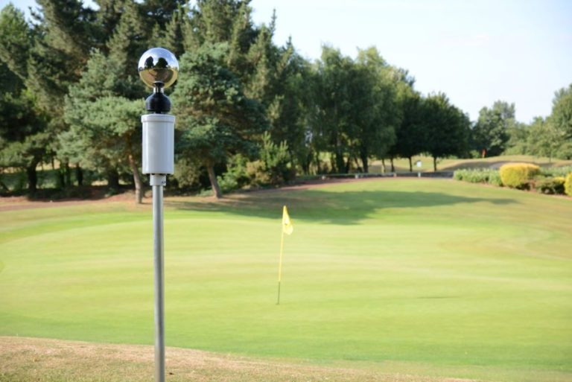
1 Lightning Dangers
How to stay safe from lightning on the golf course.
Check the forecast and check it often.
Download a reliable radar app.
Check the courses policy on lightning and if they have a lightning detection/prediction system.
Seek Shelter Immediately.
Do not stand under tall trees or sit in a golf cart. Do not stand under a lone tree, even a small one.
You must get away from your cart and away from your golf clubs quickly.
Stay away from water.
If you are old-school and have metal spikes on, take them off.
If stranded in the open, go to a low place such as a ravine or valley, or the lowest spot you can find.

Slide 11
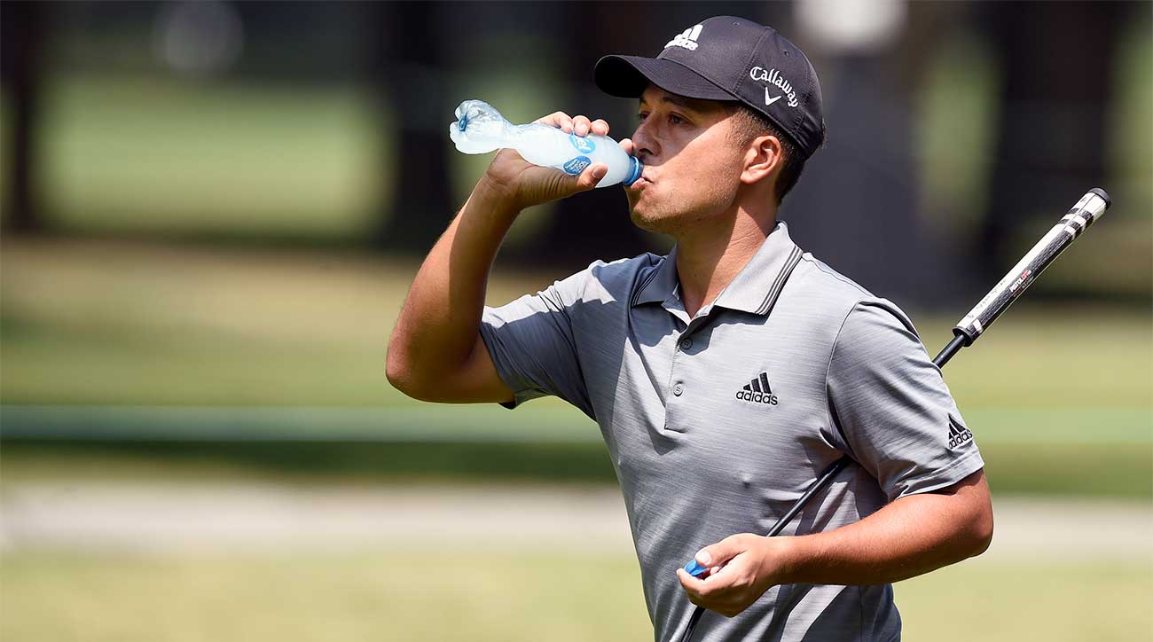
1 Dehydration
When the body puts out more liquid than it is taking in.
Ways we lose fluids:
Sweating.
Urination.
Vomiting.
Signs of dehydration:
Thirst.
Yellow or dark urine.
Dry mouth.
Lightheadedness.
Nausea and vomiting.
Dry skin.
Cease sweating.
Treatment:
Drink fluids (water, Gatorade).
Avoid physical activity.
Get inside air conditioned or cool area.

Slide 12
1 Heat Emergencies

Slide 13
1 Heat Exhaustion
Heat exhaustion symptoms:
Heavy sweating
Thirst
Fatigue
Heat cramps
Headache
Dizziness
Nausea
Vomiting

Slide 14
1 Heat Exhaustion
First aid for heat exhaustion:
Move victim from heat to rest in a cool place.
Loosen or remove unnecessary clothing.
Give water or a sports drink.
Raise feet 8-12 inches.
Put cool, wet cloths on forehead and body – spray skin with water.
Seek medical care if victim’s condition worsens or does not improve within 30 minutes.

Slide 15
1 Heatstroke
First aid for heat stroke.
Call 911.
Move victim to cool place.
Remove outer clothing.
Cool victim quickly.
Apply cold compresses or spray skin with water.
Put ice bags or cold packs beside neck, armpits, and groin.

Slide 16
1 Sunburn
Severe sunburn can be a significant first aid situation.
Sunburn is preventable with protective ointments, clothing, or staying out of the sun.
Long term effects of sunburn has been linked to skin cancers.

Slide 17
1 Sunburn
Symptoms:
Redness.
Minor inflammation, or swelling.
Pain.
Dry, peeling skin occurs as the burn heals.
Treatment:
Soak the wound in cool water for five minutes or longer.
Take acetaminophen or ibuprofen for pain relief.
Apply lidocaine (an anesthetic) with Aloe Vera to soothe the skin.
Use an antibiotic ointment and loose gauze to protect the affected area.
Make sure you don’t use ice, as this may make the damage worse.

Slide 18
1 Blisters
A blister is skin injury that is usually filled with water.
Blisters commonly occur on the feet or hands.
They are most often caused by the hands or feet rubbing against something (such as wearing new shoes).

Slide 19
1 Treatment for Blisters
Do not open the blisters, since this increases the possibility of infection.
Clean the skin around it.
Take the pressure off the area by placing a Band-Aid over the blister or Moleskin with a hole cut in the center.
If the blister accidentally breaks open, trim off the loose skin.
Keep the surface clean by washing it twice a day with an antibacterial soap (such as Dial or Safeguard).
Apply an antibiotic ointment and a Band-Aid to help with healing.

Slide 20
1 Sprains and Strains
Treat both sprains and strains with RICE.
Helps to relieve pain and swelling.
Promotes healing and flexibility.
RICE stands for:
Rest and protect the injured or sore area.
Ice or a cold pack used as soon as possible.
Compression, or wrapping the injured or sore area with an elastic bandage.
Elevation (propping up) the injured or sore area.
Aspirin or ibuprofen can help with pain and swelling.
Seek medical attention if appropriate.

Slide 21
1 Sprains and Strains
Wrapping a Sprain with an Elastic Bandage
1. Hold end in place for first turn of bandage
2. Continue with overlapping turns (overlap by about 3/4 of previous turn
3. Fasten end of bandage with clips, tape, or safety pins
88

Slide 22
Requirement #2
Study the USGA Rules of Golf now in use.
Tell about the three categories of golf etiquette.
Show that you know about the definitions of golf terms.
Show that you understand the "Rules of Amateur Status."

Slide 23
Introduction to Golf
A golf course has 9 holes or 18 holes (standard size) that cover many acres.
Each hole begins at the tee area (sometimes called a tee box); has a fairway, rough, and ends at the green where there is a hole marked with a flagstick; and usually varies in length from 100 to 600 yards.
Tee box and fairway have fairly close cut grass, green has very short grass, rough can be just slightly taller grass or something very tall (like prairie grass). The rough may also have trees and bushes and even houses. The rough acts as an obstacle and punishes you for bad shots. Bunkers and water hazards also create obstacles and make the game challenging.
Each hole has a par – a determined number of strokes to complete the hole. Par for the course is just the sum of all the pars on each hole.
The object is to get the ball in the cup in as few strokes as possible using specially designed clubs and following the rules of golf.

Slide 24
Layout of a Golf Course Hole

Slide 25
Introduction to Golf
Two most common forms are stroke play (individual) and match play (fewest strokes over set number of holes is the winner).
Match play can be individual or team (best ball).
In golf, there is no referee or umpire. Golfers police themselves to make sure they are following the rules. This is a perfect game for scouts because they are Trustworthy.
Golf is called the “gentleman’s game”.

Slide 26
Golf Etiquette

Slide 27
2. A. #1 Golf Etiquette
Courtesy
When it is someone else’s turn to play, do not move, talk, or stand too close or in their line of vision.
When on the greens, do not step in the line of another player’s putt.
If there is a group in front of you, don’t crowd them at the tee box or tee your ball before their play is completed.

Slide 28
Golf Etiquette
Fast Play
Play at an appropriate pace; do not dally. Be prepared to hit when it is your turn. Line up your shot while others are lining up theirs. Leave the green as soon as all players in your group have finished the hole.
Let faster players play through.
Play usually is in turn, with the player farthest from the hole hitting first, but in informal play, it is often prudent to hit when ready to help speed play.

Slide 29
Golf Etiquette
Care for the Course
After hitting from a bunker, be sure to rake where you walked and the area from where you hit. Do not leave the rake lying in the sand.
Avoid unnecessary practice swings to avoid damaging turf during the swing.
Replace all divots – turf that is ripped up after a shot.
Walk carefully on greens. Do not drag your feet.
When replacing the flag stick, do so carefully to avoid damaging the hole.
Basically, try to leave the course in the condition you would like to find it.

Slide 30
Basic Rules of Golf
Rule 1: The Game, Player Conduct, and the Rules
Play the ball as it lies
One of the essential principles of golf is to play the ball as it lies. This means you shouldn't move, touch, or alter the ball's position unless the rules allow it. Playing the ball as it lies helps maintain the integrity and fairness of the game.
Play the course as you find it
Similarly, you should play the course as you find it. Avoid altering the course (e.g., breaking branches or smoothing bunkers) to gain an advantage.
Player's responsibility for applying the rules
As a golfer, it's your responsibility to know and follow the rules. Always act with integrity and call penalties on yourself if necessary.

Slide 31
Basic Rules of Golf
Rule 2: The Course
Boundaries and out of bounds
Each golf course has defined boundaries, typically marked by fences, stakes, or walls. If your ball goes beyond these boundaries, it's considered "out of bounds," and you'll need to take a penalty stroke and replay the shot from the original position.
Course conditions and obstructions
Golf courses have various natural and artificial conditions, such as trees, rocks, and cart paths. If your ball lands in an abnormal course condition, you may be entitled to relief (i.e., moving the ball without penalty). Familiarize yourself with the specific rules regarding obstructions and relief to avoid unnecessary penalties.
Penalty areas
Penalty areas include water hazards (lakes, ponds, etc.) and other designated areas where playing the ball might be difficult. Hitting a ball into a penalty area usually results in a one-stroke penalty, and you'll have several options for taking relief.

Slide 32
Basic Rules of Golf
Rule 3: The Competition
Match play vs. stroke play
There are two main formats in golf: match play and stroke play. In match play, golfers compete on a hole-by-hole basis, while in stroke play, the total number of strokes for the entire round determines the winner. Know the format you're playing and how to score it correctly.
Playing in the correct order
Playing in the correct order, or "honors," is essential in golf. In stroke play, the player with the lowest score on the previous hole tees off first. In match play, the winner of the previous hole has the honor. During the rest of the hole, the ball farthest from the hole is played first.
Concessions and claims in match play
In match play, players can concede a hole or stroke to their opponent. If you believe your opponent has breached a rule, you can make a claim. Make sure to understand the procedures for making claims and concessions.

Slide 33
Basic Rules of Golf
Rule 4: The Player's Equipment
The 14-club rule
Golfers are allowed to carry a maximum of 14 clubs in their bag during a round. Carrying more than 14 clubs can result in a penalty.
Conforming clubs and balls
Ensure that your clubs and balls meet the specifications outlined by golf's governing bodies (USGA and R&A). Using non-conforming equipment can result in disqualification.
Use of equipment during play
Be aware of the rules regarding the use of equipment, such as rangefinders, club.

Slide 34
Basic Rules of Golf
Rule 5: Playing the Round and a Hole
Starting and finishing a round
Make sure you start and finish your round within the designated timeframes. Starting late or not completing a round may lead to penalties or disqualification.
Playing behind the tee
When teeing off, you must play from behind the designated tee markers. If you accidentally play from outside this area, you may incur a penalty.
Completing a hole
A hole is considered complete when your ball comes to rest in the hole. Always ensure your ball is correctly holed before moving on to the next tee.

Slide 35
Basic Rules of Golf
Rule 6: Playing a Ball
The teeing area
The teeing area is a rectangular space defined by the tee markers. You must tee your ball within this area, and you can choose any spot within the boundaries to place your ball.
Ball at rest moved
If you accidentally move your ball at rest (except on the putting green), you may incur a penalty. Be cautious when addressing the ball or searching for it in the rough.
Ball in motion deflected or stopped
If your ball in motion is deflected or stopped by an outside influence, such as another player or an animal, specific rules apply to determine how to proceed. Familiarize yourself with these rules to ensure fair play.

Slide 36
Basic Rules of Golf
Rule 7: Ball Search, Finding, and Identifying
Search time and procedures
You have a maximum of three minutes to search for a lost ball. If you can't find your ball within this time, it's considered lost, and you'll need to take a penalty stroke and play another ball from your previous position.
Identifying a found ball
Before playing a found ball, you must ensure it's yours. If you're unsure, you may lift the ball to identify it, but you must inform your fellow players of your intention and mark the ball's position before lifting it.
Lifting and replacing a ball
There are specific rules for lifting and replacing a ball during play. Be sure to follow these guidelines to avoid penalties.

Slide 37
Common Golf Penalties
Knowing the most common golf penalties and how to avoid them will save you strokes and improve your overall experience. In this section, we'll cover the penalties for a lost ball, out of bounds, unplayable lie, and water hazards.
Lost Ball
A lost ball results in a one-stroke penalty, and you must return to the spot of your previous shot and play a new ball. To avoid losing your ball, choose an appropriate club for the shot, watch the ball's flight closely, and consider using a brightly colored ball for better visibility.
Out of Bounds
If your ball goes out of bounds, you'll incur a one-stroke penalty and must replay your shot from the original position. To avoid hitting out of bounds, select a conservative target, align yourself correctly, and focus on making a smooth swing.
Unplayable Lie
An unplayable lie allows you to take relief with a one-stroke penalty. You have three options for relief: return to your previous shot's location, drop the ball within two club lengths, or move back on a straight line from the hole. To avoid unplayable lies, choose your targets wisely and be cautious when playing from difficult lies.
Water Hazards
Hitting a ball into a water hazard results in a one-stroke penalty. You have several options for taking relief, including playing the ball as it lies (if possible), dropping a ball behind the hazard, or returning to the spot of your previous shot. To avoid water hazards, consider laying up short of the hazard, select a higher lofted club for better carry, or aim for a safer target on the green.

Slide 38
2. A. #2 Golf Terms
Ace – A score of 1 on a hole. Also known as a hole-in-one.
Address – The position a player assumes when preparing to hit the ball.
Albatross – A score of three under par, also known as a double eagle. This is the hardest score in golf, much rarer than a hole-in-one.
Approach – A short hit toward the green or hole.
Apron – The short grass that surrounds a green. Also called fringe.
Away – After the tee shot, the order of play is determined by the player farthest from the hold, who is “away.”

Slide 39
Golf Terms
Backspin – a reverse rotation of the golf ball
Backswing – The backward movement of the golf club and body away from the ball before the downswing
Ball Marker – A small, flat object, usually circular, that can be used on the putting green to mark your ball so you can pick it up to clean it or move it out of the way of another player.
Birdie – A score one less than par.
Bogey – A score one more than par.
Break – the curve of the ball down the slope of the green
Bump and run – A chip shot that is designed to roll, or run, farther than it travels through the air.
Bunker – A depression in the ground that is filled with sand.

Slide 40
Golf Terms
Caddy – A person who carries a player’s bag of clubs and sometimes advises the player.
Chip – A shot that rolls farther than it travels in the air and is hit from near the green onto the green.
Club face – the surface of the club head that is designed to strike the golf ball.
Club head – the weighted part of the golf club that makes contact with the golf ball.
Course Management – the use of a plan or strategy to allow a player to use their strengths and weaknesses to finish a golf course in the fewest number of strokes.
Cross-handed – A grip that puts the left hand below the right (for right-handed players). For putting.
Cup – The metal or plastic sleeve that fits inside the hole on the green.

Slide 41
Golf Terms
Divot – Turf that is torn from the ground during a shot that digs into the ground.
Dogleg – A hole with a fairway that bends or curves to the right or left. It’s called this because it resembles a dog leg.
Downswing – The part of the swing that starts after the backswing.
Draw – A shot that starts the ball on a path to one side of the target, then gently curves back to the other side.
Drive – The first shot off of the tee.
Duck hook – A shot that curves abruptly and severely.
Duffer – An unskilled player.
Eagle – A score two less than par.
Explosion Shot – A shot that removes a large amount of sand to get the ball out.

Slide 42
Golf Terms
Fade – A slightly curving shot from one side to the other.
Fairway – The closely mowed area between the tee and the green.
Fairway Wood – Any other wood than the driver or 1-wood. Not made of wood anymore.
Fat – Hitting the ground before hitting the ball. Also called “chunking the shot”
Flagstick – Pole that holds the flag at each hole.
Flop shot – A high soft shot that stops quickly when it hits the green.
Follow-through – The continuation of a golf swing after the ball has been hit.
Fore – A word yelled out to warn golfers of a golf ball heading toward them.
Forward Press – A slight movement in the direction of the target to initiate the backswing.

Slide 43
Golf Terms
Grain – The direction the grass blades are growing.
Green – The most closely mown and smooth area on the course where the hole is located.
Green in regulation – When a golfer reaches a green within the prescribed number of strokes.
Greens fee - A charge that is paid to play a course.
Grip – The handle of a golf club.
Ground Under Repair – A marked section of the course where the ground is unfit for play. Players may take free relief from this area.
Handicap – A number that is calculated by a USGA formula for allowing players of different skill levels to fairly compete against one another.
Hazard – refers to any bunker or body of water
Hole – A 4.5 in hole in a green into which the ball is to be hit. Also refers to the tee-to-green area.
Hook – When a golf ball curves to the left (for right-handed golfer) after being hit.

Slide 44
Golf Terms
Knockdown – A shot played with less than a full swing and hit on a lower trajectory than normal.
Lag – A putt that is intended to stop close to the hole but stops short.
Lateral hazard – A water hazard that is to the side of the line of play.
Lie – The way a ball rests on the ground.
Left – The backward slant of the clubface
Loft – The angle between a club’s shaft and clubface. Higher loft causes the ball to go higher and generally shorter.
Loose Impediment – Any unattached natural objects like stones, sticks, and leaves. Golfers may move these without penalty so long as the ball does not move.
Marker – A flat object used to mark a ball’s original position on a green.
Mulligan – A second attempt or replay of a bad shot. This is never allowed in professional play.

Slide 45
Golf Terms
Out of Bounds – An area not part of the golf course and where play is not permitted and a penalty stroke is charged if the ball lands there.
Par – The score an expert golfer would be expected to make on a given hole under ordinary conditions.
Pitch – A relatively short lofted shot designed to land softly and stop quickly, usually hit with a wedge.
Pitch-and-run – A shot near the green that is intended to roll more than it travels in the air.
Pot bunker – A small deep bunker requiring a very steep angle of ascent to escape.
Preferred lies – A local course rule that allows a player to improve his or her lie without penalty. Used when a course is wet or muddy.
Putt – A shot hit with a putter on the green.
Putter – A club with a fairly straight clubface that is used for rolling (or putting) a golf ball to the green.
Putting Green – The area on the hole the player is playing that Is specially prepared for putting.

Slide 46
Golf Terms
Rough – Longer grass that is adjacent to the fairway, greens, and tee.
Round – A completed game of 18 holes.
Sand trap – A bunker filled with sand.
Stroke – The act of swinging a club.
Sweet spot – The perfect point on a clubface to hit a golf ball to make an accurate shot.
Swing plane – The plane or arc that the shaft of the club takes during the swing.
Tee – An object used to raise a ball above the ground to play it from the teeing area. It must be no longer than 4 inches (101.6 mm).
Tee box – The area the player must play from in starting the hole, defined by two tee markers.
Unplayable lie – If a player finds a ball unplayable from its current location, they may take a one-stroke penalty and move the ball.
Yardage – Distance in yards to the hole from the current location of a player’s ball.

Slide 47
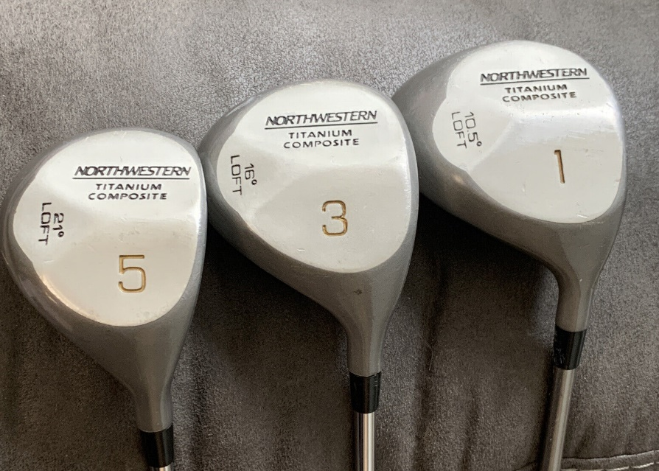
Tools of the Game
Woods
Used for teeing off and for long distance fairway shots.
Club heads were originally made of wood, but now generally some kind of steel.
Larger club heads and longer shafts than the irons.
Club numbers range from 1 (driver) up to 7.
Most golfers use the driver and 3 fairway woods.
The lower the number, the longer the yardage.

Slide 48
Tools of the Game
Irons
Generally used in the fairway after teeing off.
Club heads are narrow and made of steel.
Club numbers usually from 2-9.
Used for shorter distance shots than a driver or fairway woods.
Low numbered irons = less height (loft), more distance.
High numbered irons = more height, less distance.

Slide 49
Tools of the Game
Wedges
Called “short” irons for use close to the green.
These clubs hit the ball high with less roll on the ground.
Examples:
Pitching Wedge – for approaching the green.
Sand Wedge – for chipping the ball onto the green. Also for use in sand traps.

Slide 50
Tools of the Game
Putters
Used on the green for getting the ball into the hole.
Very flat clubfaces, zero loft.
Allow the ball to be rolled on the ground.
Many different kinds on the market.

Slide 51
Tools of the Game
Hybrids
Combine elements of woods and irons into one club.
Also called a utility club.
Designed to replace irons 2-5.
Combine forgiveness, distance, and height of fairway wood with the stopping ability of an iron.
Allow greater control and accuracy.

Slide 52
Tools of the Game
The Rules of Golf allow you to carry a mixture of up to 14 clubs.
Golfers generally have these clubs in their bags:
Driver
Fairway woods: 3 and 5
Irons: 3-9
Pitching wedge
Sand wedge
Putter
lf you are buying new clubs, try to get them fitted to you to improve your golfing experience.
Clubs that are not the right length and size for your body can be uncomfortable and affect your performance.
You will also want to carry a ball retriever (for retrieving balls from water or dense rough).

Slide 53
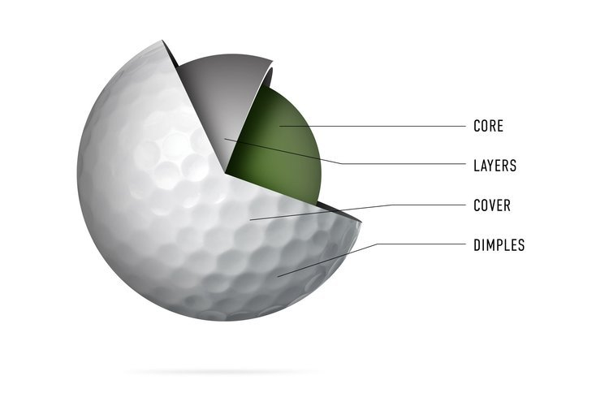
Tools of the Game
Golf Balls
There are a lot of different types. The basic differences are in the construction of the core of the ball and the covering of the ball.
Covering
Balata –ball covering made from natural rubber. Softer feel, cuts easier when hit.
Synthetics – also softer feel, but more durable than balata
Core
Wound – small rubber ball filled with liquid and wound with narrow rubber bands
Solid – two solid pieces compressed together, no liquid center. These are more common than wound.

Slide 54
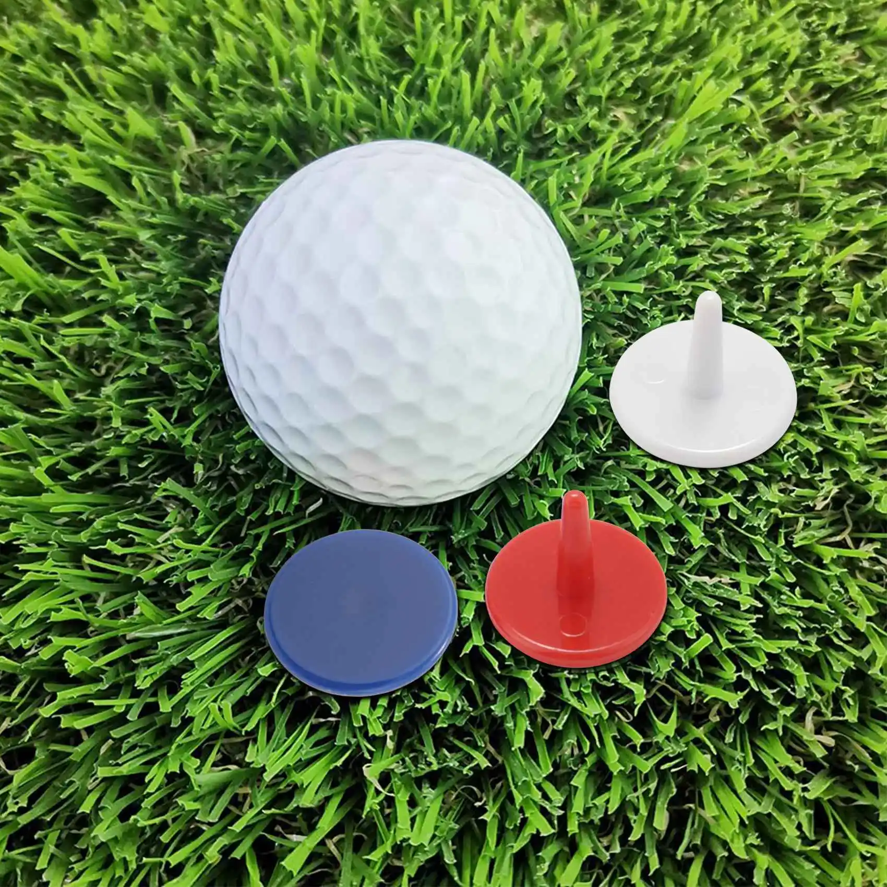
Tools of the Game
Tees
Usually plastic or wooden pegs that you place the ball on. Tees of different heights help golfers tee the ball to their desired height.
Ball Marker
For marking the location of your ball if you have to move it temporarily to allow another to play through.

Slide 55
Tools of the Game
Divot Tool
Horseshoe shaped tool for repairing ball marks on greens.
Golf Towel
Good for cleaning clubs or for wiping your hands.

Slide 56
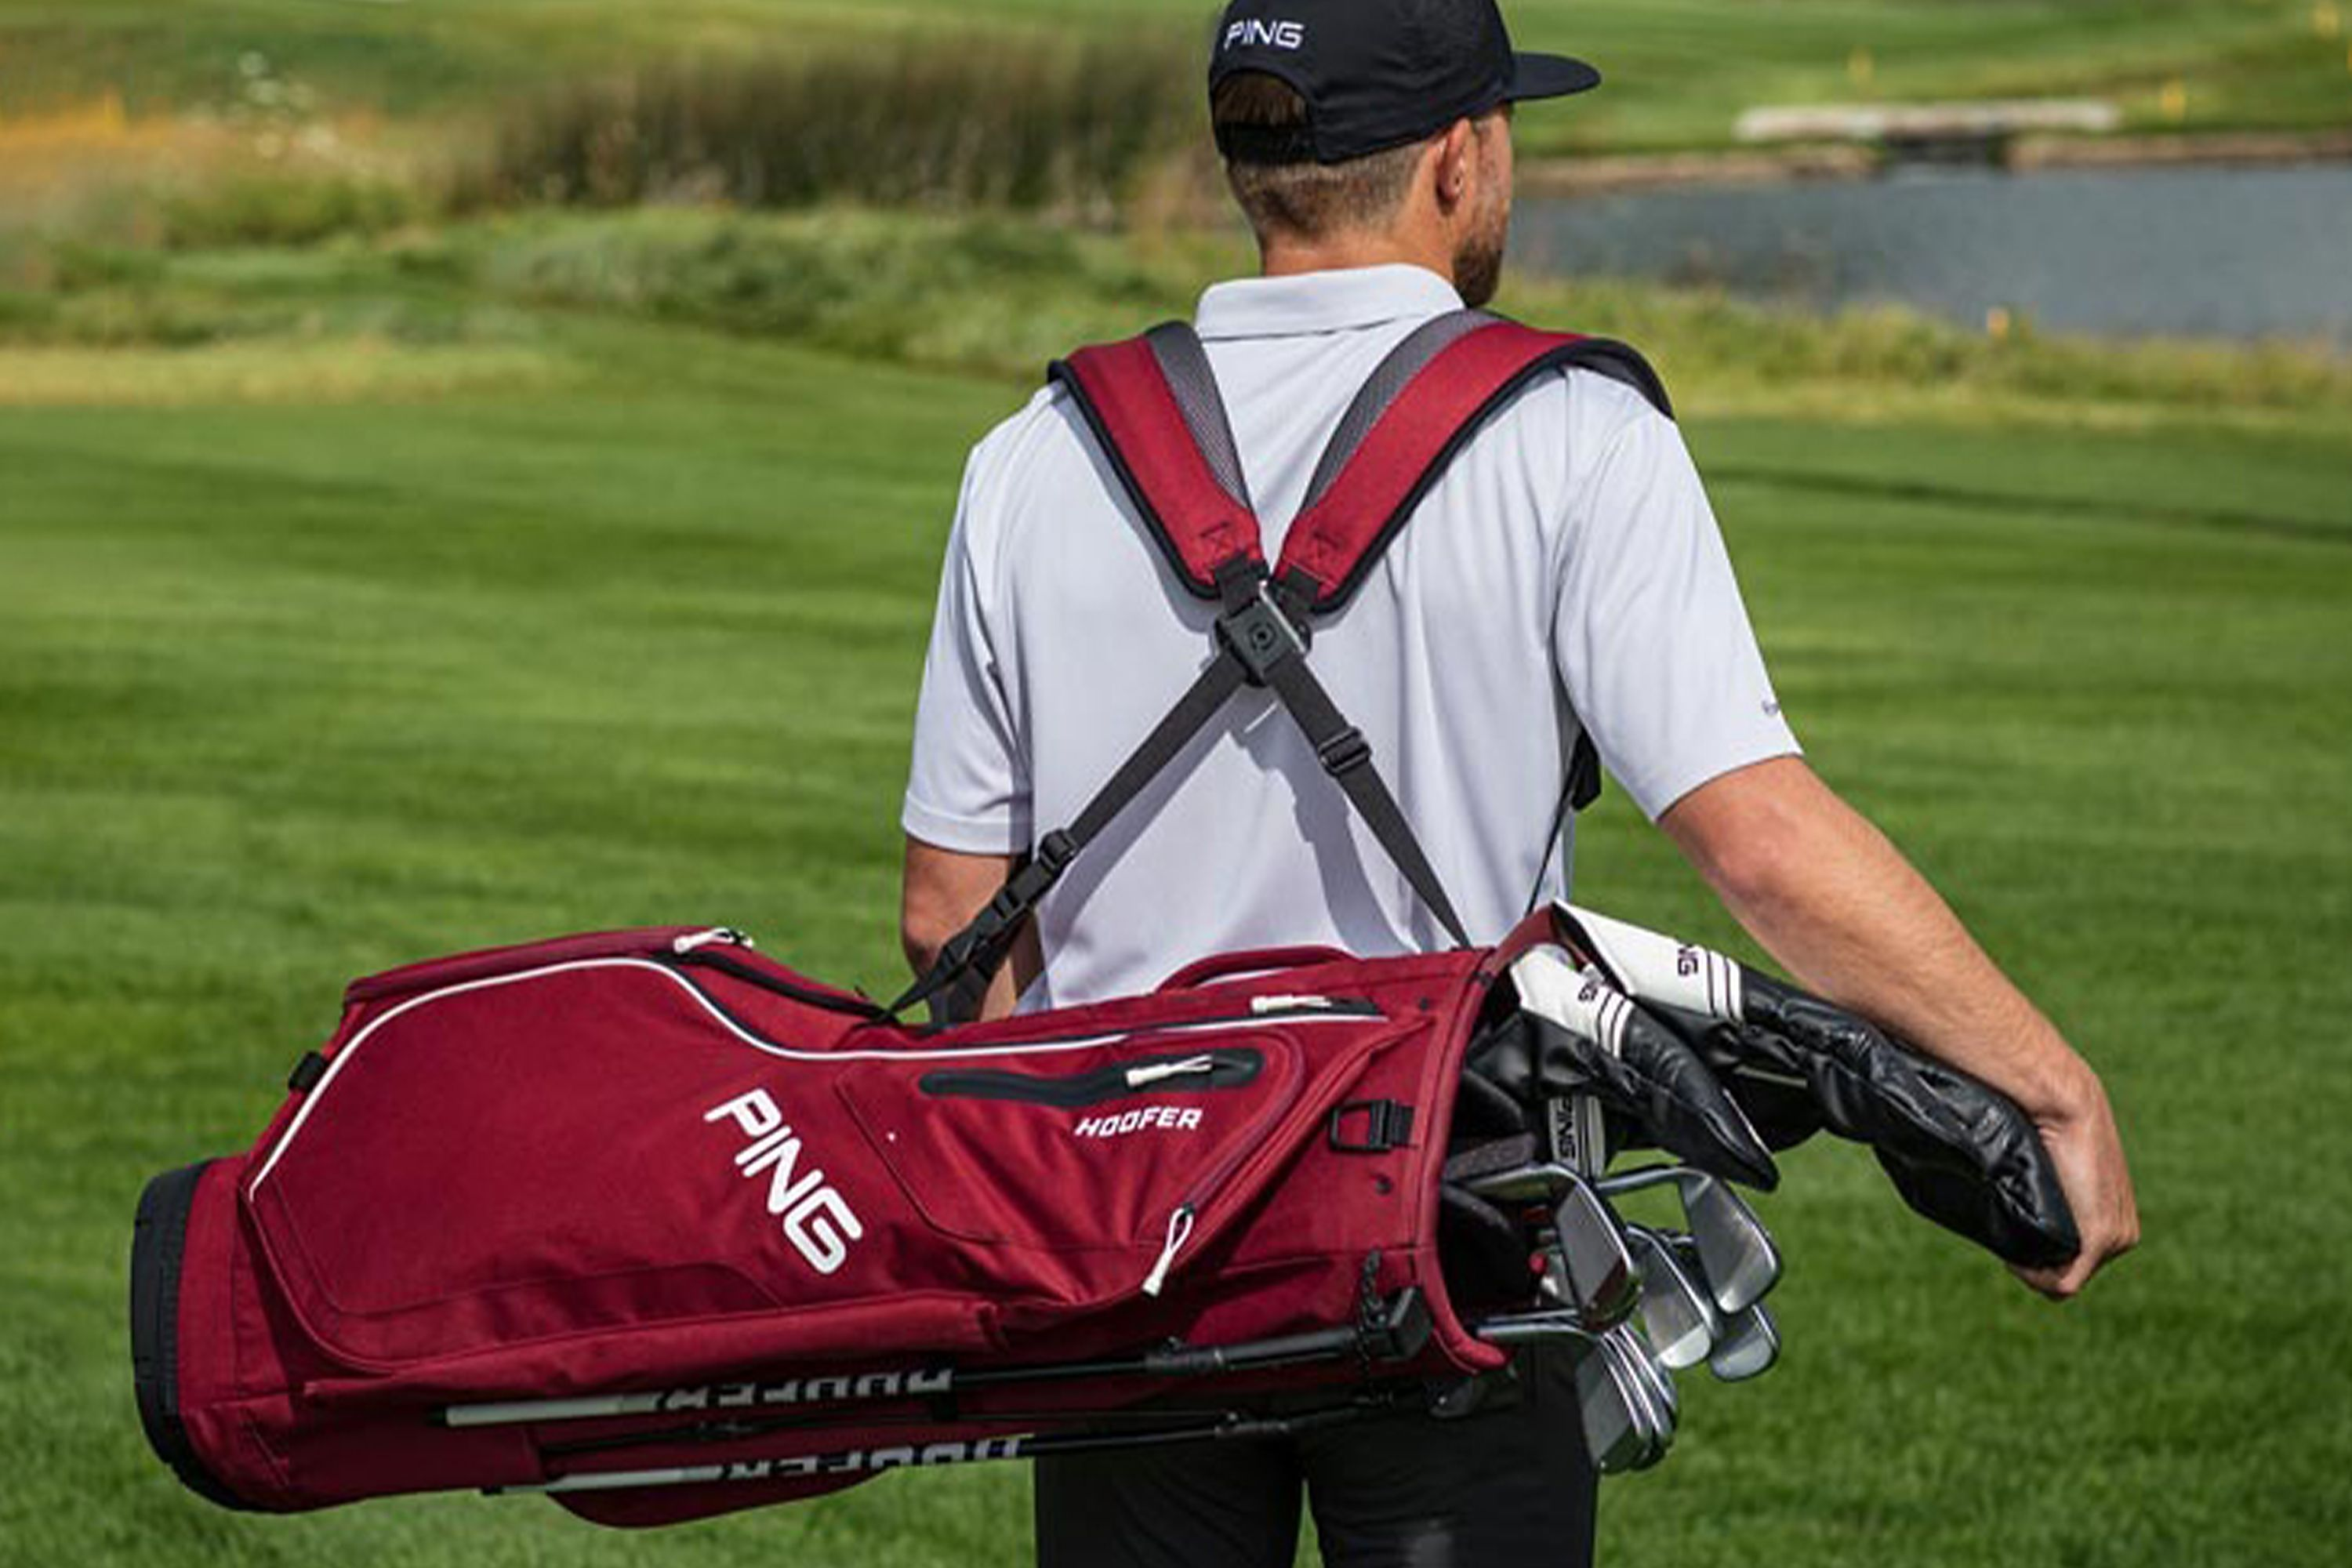
Tools of the Game
Golf Bag
Choose a lightweight bag with a few big pockets for carrying golf balls, tees, raingear, sunscreen, tools, etc. Pull carts are nice to have if you plan on walking the golf course rather than riding in a golf cart.
Club Covers
Used for covering metal woods to protect them from damage.

Slide 57
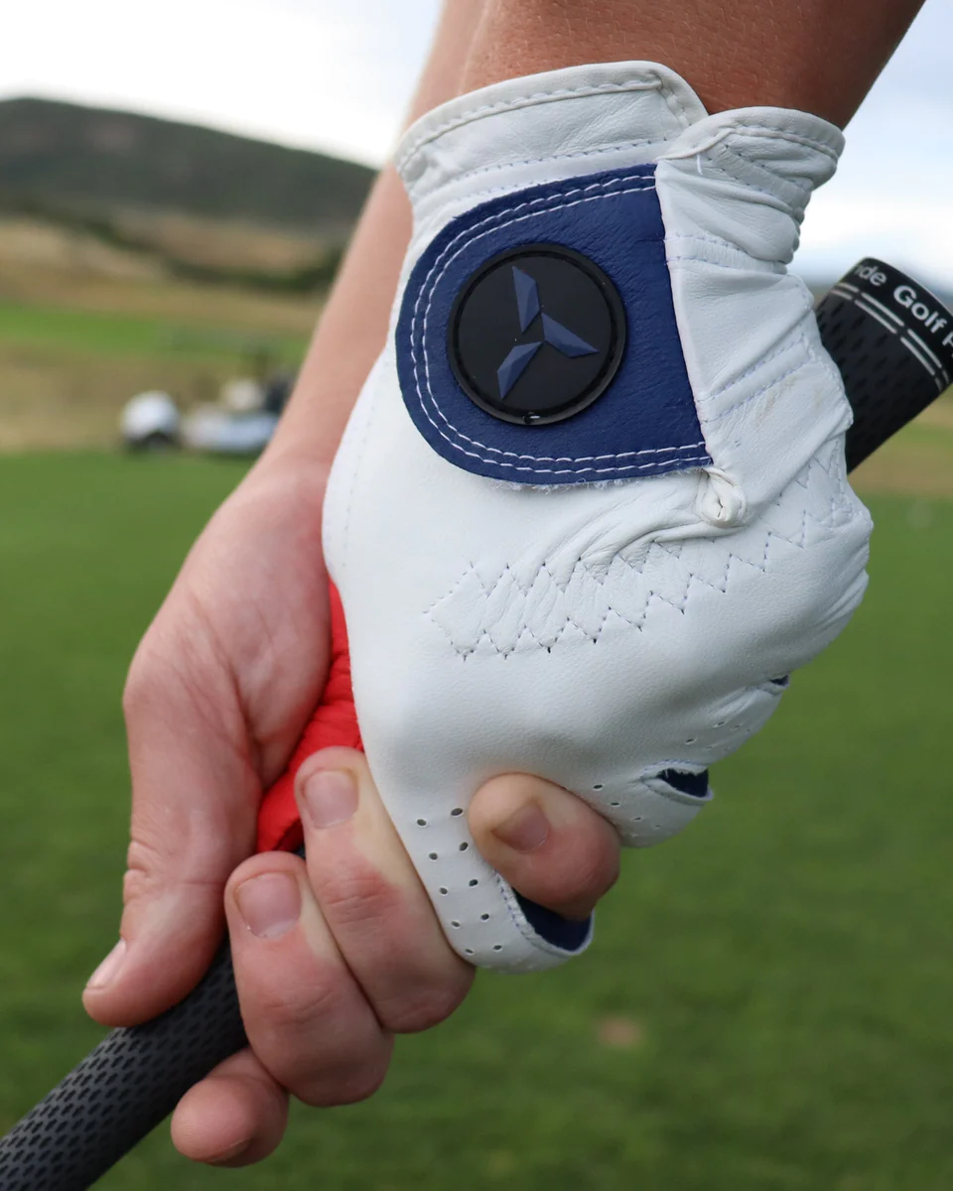
Tools of the Game
Golf shoes
These come in different styles and colors with either leather or synthetic tops. Most golf shoes are available with non-metal spikes (which most golf courses now require). The spikes are designed to keep your body from shifting during your backswings and to give you traction on slippery ground.
Golf gloves
It’s up to the individual golfer whether this is required. Some golfers never wear one. Right-handed golfers will wear a glove on the left hand. They help if your grips are worn or slippery.

Slide 58
2. A. #3 Amateur Status
All golfers are amateurs unless they:
Accept a prize that is not allowed under Rule 3 - Prizes:
An amateur playing in a competition is allowed to accept any prize, including prize money, up to a limit of $1000 in value, per competition.
Play in a golf competition as a professional.
Accept payment or compensation for giving instruction that is not allowed under Rule 4 - Instruction:
An amateur who accepts payment or compensation for giving instruction, including as part of salaried duties, becomes a non-amateur.
Are employed (including being self-employed) as a golf club or driving range professional, or
Hold membership of an association for professional golfers.

Slide 59
Requirement #2 B
Tell about your understanding of the World Handicap System.

Slide 60
Golf Handicap
A golf handicap is a numerical score that measures a golfer's playing ability.
Handicaps help level the playing field and allow players of different skill levels to compete fairly against one another.
The handicap system enables golfers of all abilities to play together and have a good time.
A golf handicap represents the number of strokes a player is expected to take above or below the course's par score.
The higher the handicap, the more strokes a player is allowed to subtract from their actual score to determine their net score.
A lower handicap indicates a more skilled golfer who is expected to have a lower net score.

Slide 61
3 World Handicap System
Today there are six different handicap systems used around the world.
The WHS unifies these six existing systems into a single system.
This will enable golfers of different abilities to play and compete on a fair and equal basis, in any format, on any course, anywhere around the world.

Slide 62
Calculating Your Handicap
To determine your handicap differential and index, you will first need some golf scores to work with.
For the best results, work with at least five scores, but using 20 scores is preferable.
Tally your gross score from every individual game.
The gross score is the actual number of strokes taken over an entire course.

Slide 63
Calculating Your Handicap
Determine your adjusted gross score. On any hole where you’ve exceeded the maximum allowable strokes, deduct the necessary number of strokes. For instance, if you took nine strokes on a hole but have a maximum allowable score of seven, subtract two from your score for that hole. Recount your total for the course using the adjusted numbers. The United States Golf Association’s equitable stroke control uses the following guidelines for a course handicap of: Nine or less: maximum score per hole is a double bogey
10 to 19: maximum score is seven
20 to 29: maximum score is eight
30 to 39: maximum score is nine
40 and above: maximum score is 10 (use this default if you haven't yet determined your handicap)

Slide 64
Calculating Your Handicap
Find the course slope. While the course rating is the difficulty rating for a golfer who shoots par (on average), the course slope is the difficulty rating based on a bogey golfer. A bogey golfer is a player who shoots 18 strokes over par, on average.
The course rating and slope for a particular course are usually found on the score card.
You can also check at the clubhouse, or on the course's website.

Slide 65
Calculating Your Handicap
Determine your handicap differential. This is a calculation involving the difference between your adjusted gross score and the course rating. The equation to determine this is:
(Adjusted gross score - course rating) x 113 ÷ slope rating
Round this number to the nearest tenth.
Repeat these steps for every score. Always use your most recent scores, up to a maximum of 20.

Slide 66
Calculating Your Handicap
Select your best handicap differentials. Choose your 10 best (lowest) differentials if you are working with 20 scores. If you don’t yet have 20 scores to work with, select:

Slide 67
Calculating Your Handicap
Average your best differentials. Add all the scores together, then divide that number by the amount of scores you're working with. For instance, if you’re working with 10 scores, add all 10 together and then divide that by 10; if you’re working with three differentials, divide the sum by three.

Slide 68
Calculating Your Handicap
Determine your handicap index. Multiply your differential average by 96 percent, or 0.96. Then, without rounding any of the numbers, delete all the numbers after the tenths decimal place. This number is your handicap index. There are maximum default handicap indexes, and they are:

Slide 69
Calculating Your Handicap
Calculating a Course Handicap
Multiply your handicap index by the slope rating.
Now that you have your handicap index, this portable number can be taken to any course and used to calculate your course handicap for any set of tees.
Again, the slope rating should be listed on your score card, at the clubhouse, or on the course's website.

Slide 70
Calculating Your Handicap
Divide the product by the standard slope rating.
This is an average difficulty rating for courses, and the USGA has determined that this average slope is 113.
So, after you multiply your handicap index by the slope rating, divide it by 113.

Slide 71
Calculating Your Handicap
Find your course handicap.
Round that number to the nearest whole number.
Any number ending in .4 or below is rounded down, and any number ending in .5 or above is rounded up.
This rounded whole number is your course handicap.

Slide 72
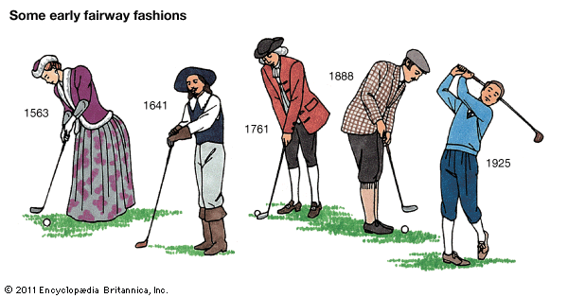
Requirement #2 C
Do the following:
Tell about the early history of golf.
Describe its early years in the United States.
Tell about the accomplishments of a top golfer of your choice.

Slide 73
Early History of Golf
Where Did Golf Originate
The game of golf as we know it today can be attributed to the Scots, although there are records of several stick and ball games throughout history.
As far back as the 13th century, the Dutch played a game where a leather ball was hit with the intention of reaching a target several hundred yards away.
The winner would be the player who reached the target with the fewest shots.
However, the Scottish sport, which was known as Golf, had one distinction that separates it from similar sports in history: the hole.
When we’re talking about the modern game with 18 holes, golf history traces its origins back to 15th century Scotland.

Slide 74
Early History of Golf
The History of Golf
The game is first mentioned in an Act of Scottish Parliament in 1457, which called for it to be banned alongside football.
King James II of Scotland prohibited the playing of games as it was a distraction from military training, and he felt perfecting archery would be a more worthwhile sporting pursuit.
After several more bannings throughout the 15th century and golf being lambasted as an unprofitable sport, restrictions on playing the game were removed with the Treaty of Glasgow coming into effect in 1502.
Today, the Scots are extremely proud of their golfing heritage and their “ancient” courses that continue to pull in thousands of visitors to the small country each year as they continue to play their part in the history of golf.

Slide 75
Early History of Golf
Developing Rules for the Game
The oldest recorded rules for the game date back to the year 1744, where The Honourable Company of Edinburgh Golfers published “Articles and Laws in Playing at Golf.”
This ancient piece of golf history, which now remains in the National Library of Scotland, gave fame to the Muirfield club being the longest surviving club in the history of golf.

Slide 76
Early History of Golf
Spreading Golf Around the World
Scottish soldiers, immigrants, and expatriates played a pivotal role in the history of golf.
They were responsible for spreading the game around the British Isles during the 18th century. However, it wasn’t until the 19th century that the game started to gain an international presence.
The oldest golf courses outside of Britain are to be found in nearby France, with the establishment of the Royal Calcutta Golf Club in 1829 and the club at Pau in 1856.
By 1880, golf had spread to Ireland, many other parts of Europe, Australia, New Zealand, Canada, Singapore, and South Africa.
Meanwhile, back in Britain, the game enjoyed increased popularity. By 1880, England had 10 golf courses, which rapidly increased to 1000 by 1914.

Slide 77
Early Golf in the U.S.
Adoption in the U.S.
There is evidence to suggest that golf was enjoyed in America during the 18th century.
A shipment of golf equipment to Charleston, South Carolina in 1739, aided in the founding of the South Carolina Golf Club in 1787 and an advertisement for golf clubs and balls in the Royal Gazette of New York City in 1779.
However, much like other parts of the world who adopted the sport early, no real traction was gained until early 19th century. In 1894 the United States Golf Association was formed to become ambassadors for the game in the states, which by 1910 was host to 267 golf clubs.
The PGA was established in 1916.
The Broadmoor golf course at Colorado Springs Resort in 1918

Slide 78
Top Men Golfers
Tell about the accomplishments of a top golfer of your choice.
Greg Norman
Rory McIlroy
Vijay Singh
Billy Casper
Ernie Els
Walter Hagen
Nick Faldo
Lee Trevino
Byron Nelson
Seve Ballesteros
Phil Mickelson
Gene Sarazen
Gary Player
Tom Watson
Bobby Jones
Ben Hogan
Arnold Palmer
Sam Snead
Jack Nicklaus
Tiger Woods

Slide 79
Top Women Golfers
Tell about the accomplishments of a top golfer of your choice.
Kathy Whitworth
Mickey Wright
Annika Sorenstam
Patty Berg
Louise Suggs
Betsy Rawls
Nancy Lopez
JoAnne Carner
Sandra Haynie
Babe Zaharias
Karrie Webb
Patty Sheehan
Betsy King
Pat Bradley
Juli Inkster
Amy Alcott
Se Ri Pak
Dame Laura Davies
Inbee Park
Lorena Ochoa

Slide 80
Requirement #2 D
Do the following:
Tell how golf can contribute to a healthy lifestyle, mentally and physically.
Tell how a golf exercise plan can help you play better. Show two exercises that would improve your game.

Slide 81
Healthy Lifestyle with Golf
Golf can be good for your health and your heart.
Walking an average course for a round of golf can be between 3 to 5 miles.
If you walk 18 holes three to five times a week, you’ll get an optimal amount of endurance exercise for your heart.
If you pull your clubs or carry them, you’ll burn even more calories each round and benefit even more.
Playing golf regularly can help you:
Stay fit.
Improve muscle tone and endurance.
Lose weight and body fat.

Slide 82
Healthy Lifestyle with Golf
Other benefits of golf:
Reduces stress due to physical activity and the joy of being close to nature.
Is an excellent way to stay in touch with friends.
Improves social interactions by bringing together people who have a shared interest.
Develops a sense of bonding with your community.
Helps you retain a sense of achievement by becoming better at something that you enjoy doing.
Actively engages your body and mind.

Slide 83
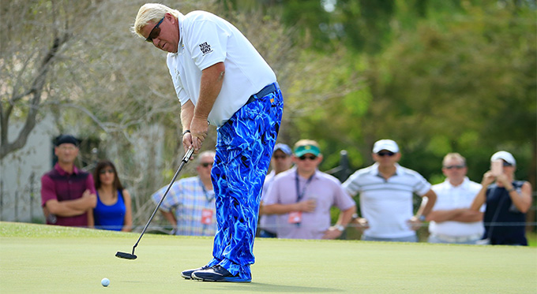
Exercise Plan for Golf
Do you need to work out to play golf?
Prior to the mid 1990’s, fitness was not something golfers cared about.
Professional golfers rarely exercised and you didn’t see many “buff” players walking down the fairway.
This all changed when Tiger Woods hit the scene.
He was an athlete playing golf and he aggressively worked on his body to make himself a better player. He changed the game.
Professional golfers now have rigorous workout schedules and college golf teams all have strength and conditioning coaches.

Slide 84
Exercise Plan for Golf
There are several ways that consistently doing a golf workout will help you shoot lower scores.
First, building strength in the correct muscle groups will allow you to increase your swing speed and add distance to your shots.
Second, improved flexibility and balance will improve your swing and add additional speed.
Finally, stamina is more important in golf than amateur players realize.

Slide 85
Exercise Plan for Golf
Exercises for the forearms, wrists, and hands.
Hand Squeeze/Crunch
Take a tennis ball and put it in the palm of your hand and squeeze as hard as you can for 20-30 seconds. The longer and tighter your hold is, the more your hand might start to shake, but hold on for as long as you can. Try the other hand and continue to do so with five sets in each hand.
Rubber Band Extensions
Take rubber bands and wrap them around the first set of knuckles and extend your fingers out away from each other for 20-30 seconds. Try the other hand and do this five times by either trying to extend your fingers further away or adding more rubber bands over time.

Slide 86
Exercise Plan for Golf
Exercises for the forearms, wrists, and hands.
Golf Club Pinches
Take a few clubs and hold them off the ground in the fingertips of your hand. Squeeze and maintain control of the club for 20-30 seconds and then switch hands. Adding more clubs which will add more weight for the fingers to hold up and control. Don’t let the ends of the clubs touch the palm of your hand or drop or touch the ground.
Golf Bag Finger Hold
Take a golf bag and place your fingers inside the hand grip and hold off the ground for 20-30 seconds. Try the other hand and do this five times for each hand. Lifting the bag further off the ground to increase difficulty, but if is too heavy, take some clubs out and add them over time.

Slide 87
Exercise Plan for Golf
Simple Core Exercises That Will Help Your Golf Game
Forearm planks
The key to accurately performing this plank is to create a flat back, tight core, straight legs and 90 degrees at the elbows. This position will allow you to feel the most muscle activation in your core.
Reps: Perform a plank for 30-60 seconds, for 3-4 rounds.

Slide 88
Exercise Plan for Golf
Simple core exercises that will help your golf game.
Side plank
To get into the side plank position, lie on your right side, with legs straight and feet stacked on top of each other.
Put your right elbow under your right shoulder, forearm pointing away from your body, to create a straight line from toes to head with a 90 degree bend on one elbow.
Then, lift your hips off the ground so you’re supporting your weight on your elbow and bottom foot.
Rest your hips back on the ground and flip to your left side.
Reps: 30-60 seconds per side, 3-4 rounds.

Slide 89
Exercise Plan for Golf
Simple core exercises that will help your golf game.
Hollow holds
To perform this exercise, lie on your back and extend your arms overhead. Then, lift shoulders and feet off the floor while maintaining straight arms, legs and a tight core.
Reps: 30-60 seconds per side, 3-4 rounds.

Slide 90
Exercise Plan for Golf
Simple core exercises that will help your golf game.
Single-arm, single-leg plank
To start, assume a normal plank position. Using opposite hand and opposite foot working at the same time, alternate lifting hand and foot every five seconds.
Reps: 30-60 seconds per side, 3-4 rounds.

Slide 91
Exercise Plan for Golf
Simple leg exercises that will help your golf game.
Bodyweight squats
Bodyweight squats are an excellent way to work out your legs without any equipment.
Stand with your feet shoulder-width apart, and lower your body until your thighs are parallel to the ground.
Make sure to keep your back straight and your knees aligned with your toes.
Then, push through your heels to stand back up.
Do three sets of 10 to 15 reps.

Slide 92
Exercise Plan for Golf
Simple leg exercises that will help your golf game.
Lunges
Lunges are another great bodyweight exercise that can help strengthen your legs.
Stand with your feet shoulder-width apart and step forward with one foot.
Lower your body until your front knee is bent at a 90-degree angle.
Then, push off your front foot to return to a standing position.
Repeat with your other leg. Do three sets of 10 to 15 reps on each leg.

Slide 93
Exercise Plan for Golf
Simple leg exercises that will help your golf game.
Single Leg press with resistance band.
Lie down on the floor
Double up the band – Grab the band with both hands and put it around one foot
Extend your leg until reaching full extension
Return slowly to the starting position (resist against the pull of the band)
Do three sets of 10 to 15 reps.
Don’t forget the other side!

Slide 94
Exercise Plan for Golf
Simple leg exercises that will help your golf game.
Deadlifts
Deadlifts are another gym-based exercise that can help improve your leg strength for golf.
Stand with your feet shoulder-width apart and a barbell on the ground in front of you.
Bend down to pick up the barbell, keeping your back straight and your knees bent.
Stand up, lifting the barbell with you until you are standing straight up.
Then, lower the barbell back down to the ground.
Do three sets of 10 to 15 reps.

Slide 95
Requirement #2 E
Show the following:
The proper grip, stance, posture, and key fundamentals of a good swing.
Driver played from a tee.
The fairway wood shot.
The long iron shot.
The short iron shot.
The approach, chip-and-run, and pitch shots.
A recovery shot from a bunker or heavy rough.
A sound putting stroke

Slide 96
Proper Grip
The grip is the manner in which a player holds the club.
There are three primary grips that golfers use:
Vardon Grip (Overlap Grip)
Interlocking Grip
Baseball Grip (10 Finger Grip)

Slide 97
Proper Grip
The Vardon grip – or overlap grip – is used by 90% of Tour players and an overwhelming majority of amateur golfers around the world.
It is named after the British golfer that was the first to promote its benefits and win major tournaments with it, Harry Vardon.
In the overlap grip, both hands are connected through the right pinky finger which will lie on top of the depression between the left hand’s index and middle fingers.
As such, the right hand will stay in close contact with the left thanks to this anchor.
The long fingers and strong hands associated with adult male golfers are most suited for this type of grip whereas children or golfers with relatively small fingers would likely benefit from different types of grips.

Slide 98
Proper Grip
The second most widely used grip in golf is the interlocking grip.
This type of grip will again see both hands connect to each other through the right hand’s little finger and the left hand’s index finger.
But in this case, those fingers will cross rather than sit one on top of the other.
As its name suggests, both hands will be held securely close to one another thanks to this locking position.
The interlock grip is quite useful for golfers with smaller than average hands and fingers.

Slide 99
Proper Grip
The baseball grip, or otherwise known as the 10 finger grip will see both hands pressed against each other on the grip.
However, in contrast to the other types of golf grips, no anchor will link them at all.
Indeed, rather than sitting on top of other fingers or crossed with the index finger the right little finger will simply lie next to the left index finger, pressed against it.
This type of grip is usually adopted by young children as they begin swinging the club for the first times.
It is also used by senior golfers who have difficulties wrapping their hands around the club using any other technique, perhaps because of flexibility issues or pain in their fingers.

Slide 100
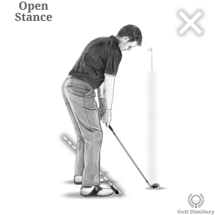
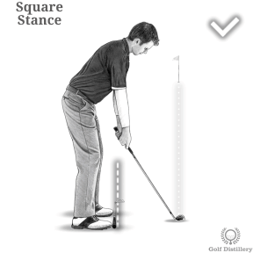
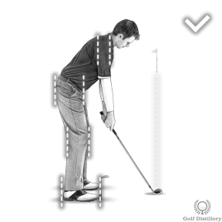
Proper Alignment
A consistent golf swing and a consistent golf game can only be built on proper alignment.
To check your alignment, pick a target in the distance and set up to the ball as normal. Place a club along the line of your toes, step back and see where the club points:
If the club points to the right of the target, your stance is what we call closed.
If the club points to the left of the target, your stance is what we call open.
The club should point parallel left of the target (imagine the line along your feet and the line from the ball to the target are like 2 train tracks). This is a square stance.
Remember – your knees, hips and shoulders should be in line or parallel to your feet.

Slide 101
Proper Stance
A golf stance is made up of several elements – the right width of stance, the right amount of knee flex, the angle of the feet and overall posture.

Slide 102
Proper Stance
Watch the proper golf stance video by clicking on the image.

Slide 103
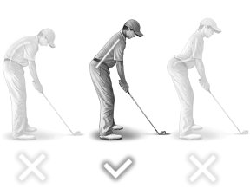
Proper Posture
Great golf posture is crucial for consistent, accurate and powerful ball striking.
The golf swing is essentially a turning motion around a central column – that central column being your spine.
The better the position and the angle of your spine at address, the better it will be throughout the swing, especially at impact.

Slide 104
Proper Posture
Watch the proper golf posture video by clicking on the image.

Slide 105
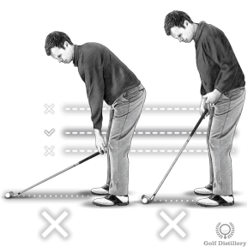
Proper Distance to Ball
How far or close should you be from the ball?
Because each club in the bag is a different length, your distance to the golf ball is going to change accordingly.

Slide 106
Proper Distance to Ball
Watch the distance you set up to the golf ball video by clicking on the image.

Slide 107
Proper Swing
This section will break down the complex actions that combine to make a classic golf swing into golf swing basics and encourage you to incorporate them into your existing golf swing.

Slide 108
Proper Swing
Watch the proper golf swing video by clicking on the image.

Slide 109
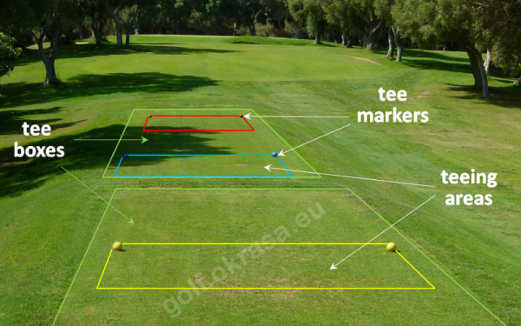
Driving from a Tee
The teeing area is the designated starting point of each hole on a golf course, extending two club lengths back from the front edge of the tee markers and encompassing the space in between them.
You must tee up your ball between the markers.
Golf courses utilize different colors to provide players of different skill levels with an appropriate challenge.
These boxes, typically distinguished by color, including red, white, blue, and black, offer varying levels of difficulty and yardage.
Red tees are generally designed for less experienced players
White tees are designed for seniors or beginners
Blue tees are suited for mid to low-handicap players
Black tees are designated for advanced golfers.

Slide 110
Driving from a Tee
Watch “How to Use the Driver for Beginners” video by clicking on the image.

Slide 111
Fairway Wood Shot
Watch “How to Hit Fairway Woods” video by clicking on the image.

Slide 112
Fairway Wood Shot
Like other clubs, different sizes help with different distances. Here’s the general rule of thumb on which wood to use:
3-wood = 125 to 240 yards.
4-wood = 110 to 220 yards.
5-wood = 105 to 215 yards.
7-wood = 90 to 170 yards.

Slide 113
Using the Irons
Watch “Important Iron Lesson” video by clicking on the image.

Slide 114
Using the Irons
Usually, the irons come out when you’re less than 200 yards away from the green.
The closer you are to the green, the higher the iron you will use.
Here are some guidelines around which iron to use:
2-iron = 105 to 210 yards.
3-iron = 100 to 205 yards.
4-iron = 90 to 190 yards.
5-iron = 80 to 175 yards.
6-iron = 70 to 165 yards.
7-iron = 65 to 155 yards.
8-iron = 60 to 145 yards.
9-iron = 55 to 135 yards.

Slide 115
The Approach
Your approach shot is when you hit the ball with the intention of landing it into the green.
Approach shots, unlike your putt, are taken with a full swing of your club.
Club selection is crucial for an approach shot.
Golfers typically choose an iron or a wedge depending on the distance to the hole.
Longer approach shots may require a mid-iron or a hybrid club, while shorter shots may call for a pitching wedge, sand wedge, or even a lob wedge.

Slide 116
Chip and Run
The chip-and-run is a very useful shot when you don’t have any hazards between you and the pin and when the fairway is quite flat and closely mown.
For a chip-and-run, select a club that gets the ball running on the ground soon after impact; typically, the 8 or 9-iron are good clubs for this shot.
It involves hitting the ball low landing it on the front of the green and letting it run to the hole like a putt.

Slide 117
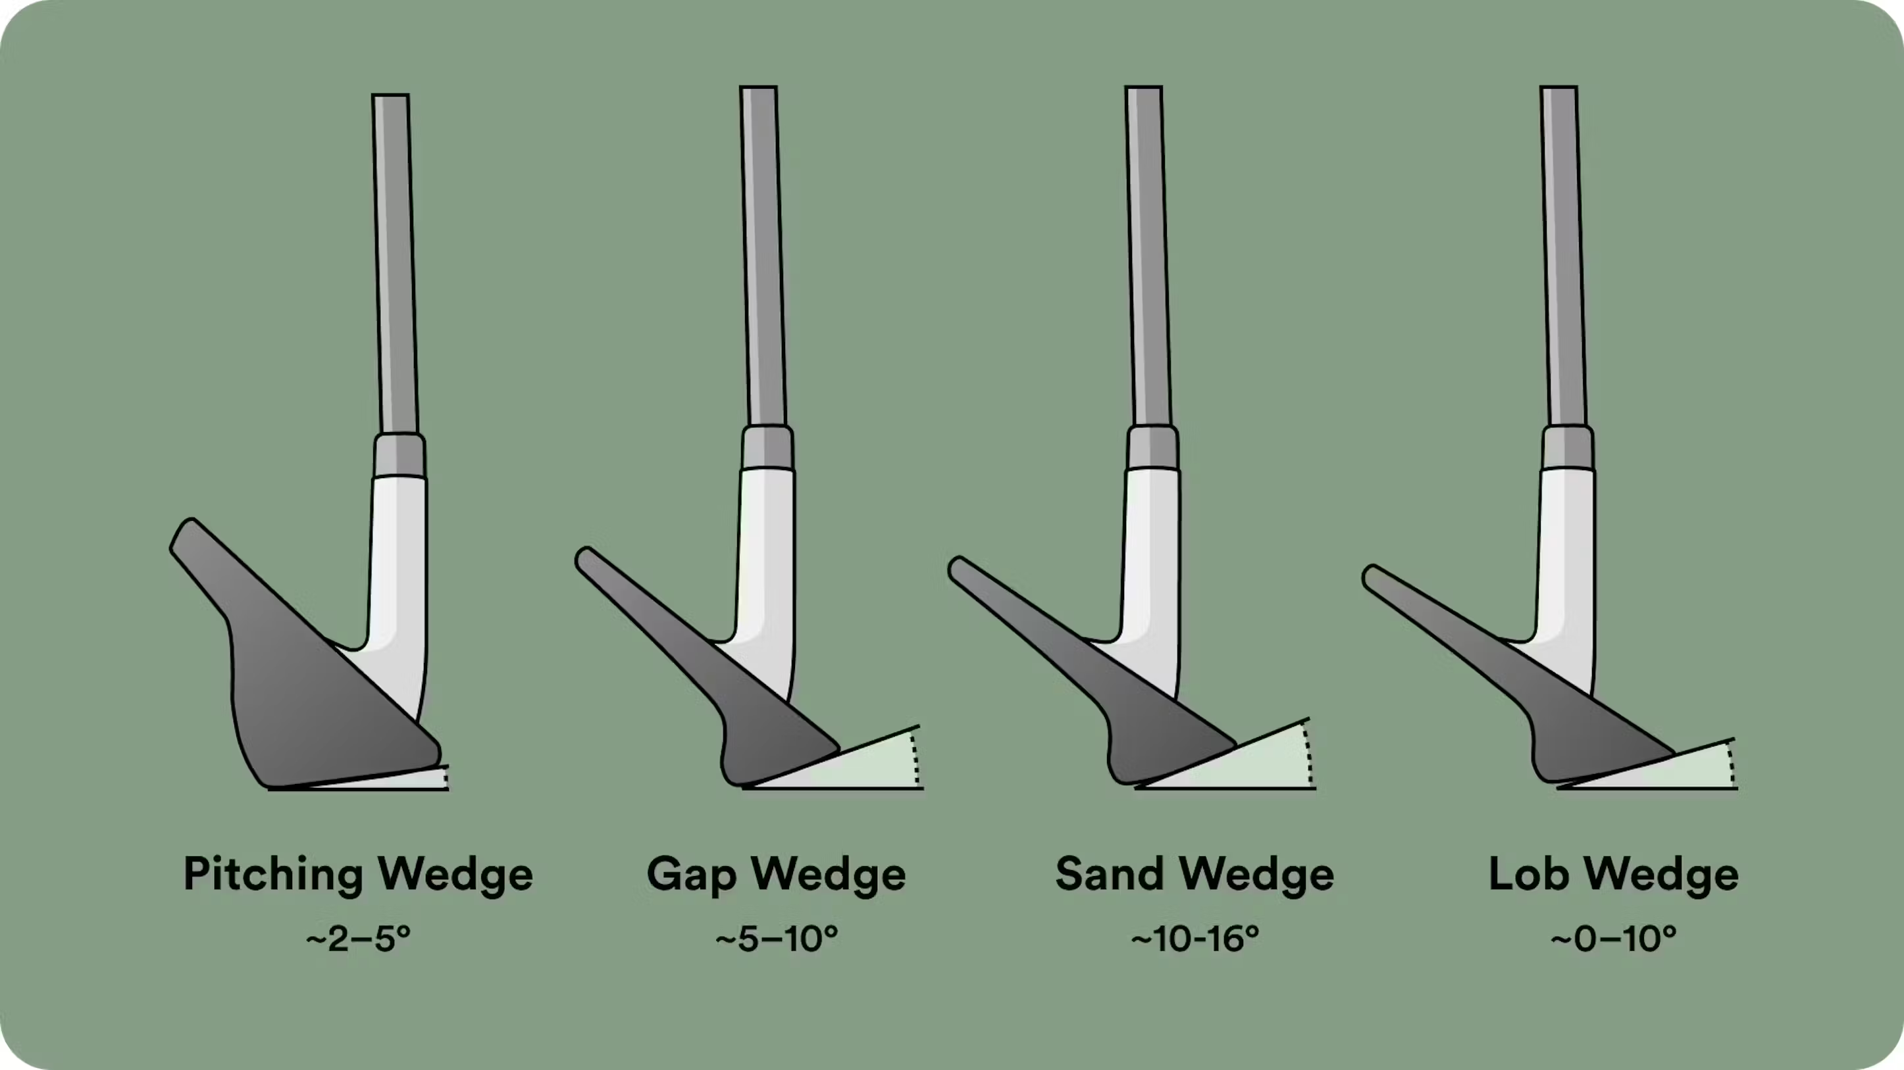
Pitch Shots
Pitch shots are played onto the green, typically from 40-50 yards and closer.
A "pitch shot" is played with a highly lofted club that is designed to go a relatively short distance with a steep ascent and steep descent.
When determining what shot you want to hit for these situations, you have to look at the proportionate amount of green to the total length of the shot.
The less green there is to work with, the higher shot you will need.
You can use a pitching wedge or a gap wedge for your pitch shots.
The most obvious time to use a pitch shot is when there is an obstacle like water or a bunker between the ball and the hole.

Slide 118
Bunker Recovery
The Club
Use a Sand Wedge.
Lob wedges can be used when you're more skilled.
The Stance and Setup
Feet: Align feet left of the target. This can be anywhere between 2 and 10 yards, play around with it in the practice bunker - it's totally up to you and what works for you.
Club face: Open the face and have the leading edge pointing either at the hole or slightly right of it, no more than a couple of yards to the right.

Slide 119
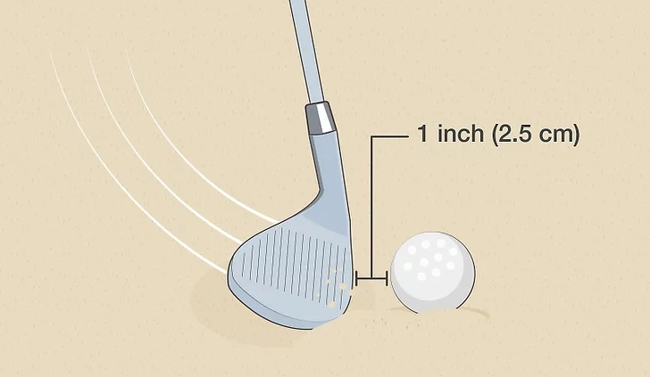
Bunker Recovery
Ball position: The ball should be played off the front foot. This will automatically open your club face and set your hands behind the ball.
Hands: Hands should be behind the ball. Grip down on the club with your hands about 2 inches from the top of the club.
Hitting the shot
When you hit the ball, you enter the sand an inch behind the ball.
FOLLOW THROUGH to the finish like any other shot.
Don't stop the club in the sand.
When you swing the club, swing it so your swing follows the line of your feet which is left of the target.

Slide 120
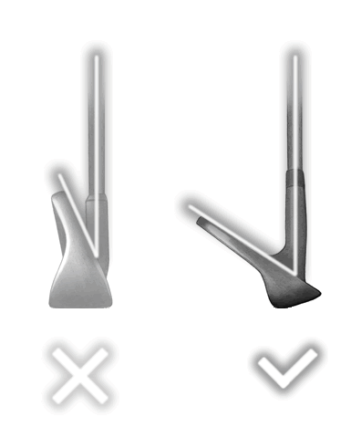
Heavy Rough Recovery
How to Hit from Heavy Rough
For the average golfer, it is best to accept the situation, take your medicine, and aim for the safest way back into the fairway.
Use a Lot of Loft
Depending on how deep into the rough the ball is located, and how far away from the fairway you are you may elect to take the club with the highest loft in your bag.
That means taking your lob or sand wedge, which should give you between 60 and 56 degrees of loft, and the best chance to see the ball fly out of the rough and back into safety.

Slide 121
Heavy Rough Recovery
Position the Ball Back in your Stance
In order to minimize the slowing effect of the grass on your club speed you can position the ball a little further back in your stance.
Hitting the ball sooner in the swing arc will translate into fewer grass blades catching your club head before it strikes the ball.
All in all, doing so should help in keeping your club head speed, or at least the speed reduction – if any – will occur after you strike the ball and after the ball is airborne.

Slide 122
Heavy Rough Recovery
Stand a Little Closer to the Ball
Standing closer to the ball than you normally would will position the shaft of your club in a more upright position.
A club that is more upright will be coming down towards the ball in a more vertical fashion.
Coming in vertically will reduce the amount of grass that will touch your club head, which would slow it down in the process.

Slide 123
Heavy Rough Recovery
Open the Clubface a Little
Opening the clubface at address slightly will help counter the twisting effect the grass will have on your club head.
Indeed, grass will tend to grip the heel of your club head first, will twist it and put your club in a closed position.
Address this by opening the clubface a little and raise your chances that your club will be square when it hits the ball.

Slide 124
Heavy Rough Recovery
Hold the Club Tightly
Even if you tweak your swing so that it is more vertical than flat, your club is still going to travel through grass that will try to grip and twist your club head.
In order to maintain the clubface in its correct angle grip the club more tightly than you normally would.
This will allow you to power through the grass without too much impact into your club and ultimately into your shot.

Slide 125
Heavy Rough Recovery
Swing Hard
Again, you’ll need for your club head to travel through a lot of thick and long grass on its way to the ball.
And that grass will slow down your club significantly so you’ll need plenty of club speed to go through it all.
Therefore, don’t try a little delicate swing but rather go for it and swing hard at the ball.
Even with a faster swing, the tall grass may not even allow for a follow through, which is fine in these circumstance.

Slide 126
Sound Putting Stroke
Watch “Golf Putting Simplified” video by clicking on the image.

Slide 127
Requirement #2 F
Play a minimum of two nine-hole rounds or one 18-hole round of golf with another golfer about your age and with your counselor, or an adult approved by your counselor. Do the following: :
Follow the "Rules of Golf".
Practice good golf etiquette.
Show respect to fellow golfers, committee, sponsor, and gallery.

Slide 128
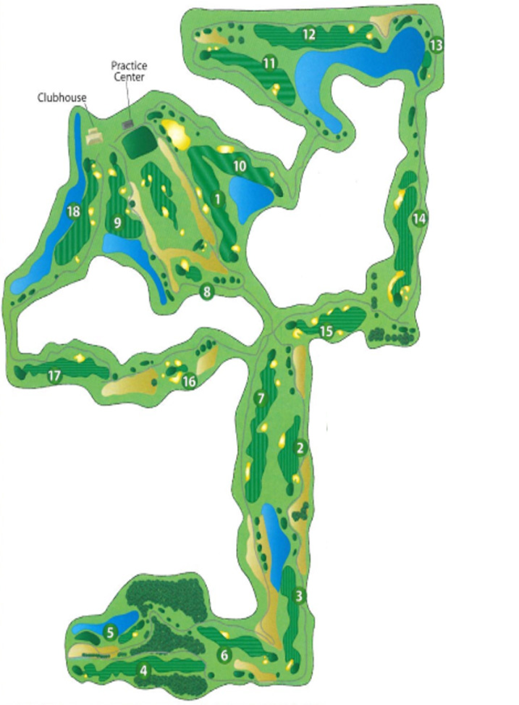
Area Golf Courses
Click on PGA.com above to locate golf courses near your location.
Stone Ridge Golf Club
Bowling Green, OH

Slide 129
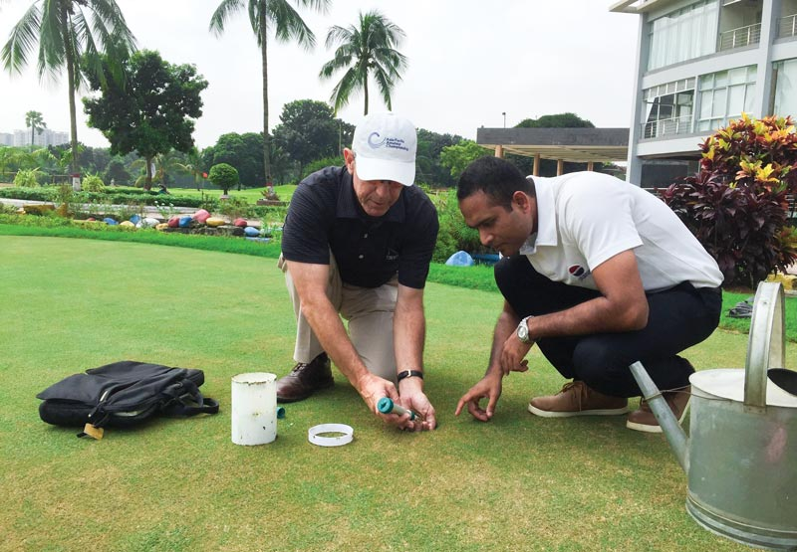
Requirement #2 G
Discuss with your counselor vocational opportunities related to golf.

Slide 130
Job Opportunities
Club Professional
Most golf professionals serve at public and private courses where they provide lessons, operate golf shops, direct staff, and help conduct tournaments.
A club professional must attend schools conducted by the PGA, pass playing tests, and complete an apprentice program.

Slide 131
Job Opportunities
Touring Professional
These players devote themselves to tournament play and make their living by competing for prize money.
They often travel nationwide and worldwide to compete.
The PGA, LPGA, and the LIV are the main organizations that offer the most prize money.
Satellite tours are available for players who are hoping to elevate their games and earn playing privileges on the larger tours.

Slide 132
Job Opportunities
Professional Instructors
These professionals concentrate only on teaching.
Many teach at instructional centers and use technology that includes video to help students improve their game.
Some instructors specialize in certain areas of the game, such as the short game.

Slide 133
Job Opportunities
Sports Psychologists
Because golf can be as much a mental challenge as a physical challenge, a growing number of golfers work with sports psychologists.
These specially trained professionals work with athletes to help them eliminate destructive mental thoughts and concentrate on the positive thoughts.

Slide 134
Job Opportunities
Golf Course Architect
With the growing number of golf courses being built, there has been an increase in the number of golf course designers and architects.
Designing courses usually involves knowledge of landscaping, engineering, turf, grasses, and environmental statutes.

Slide 135
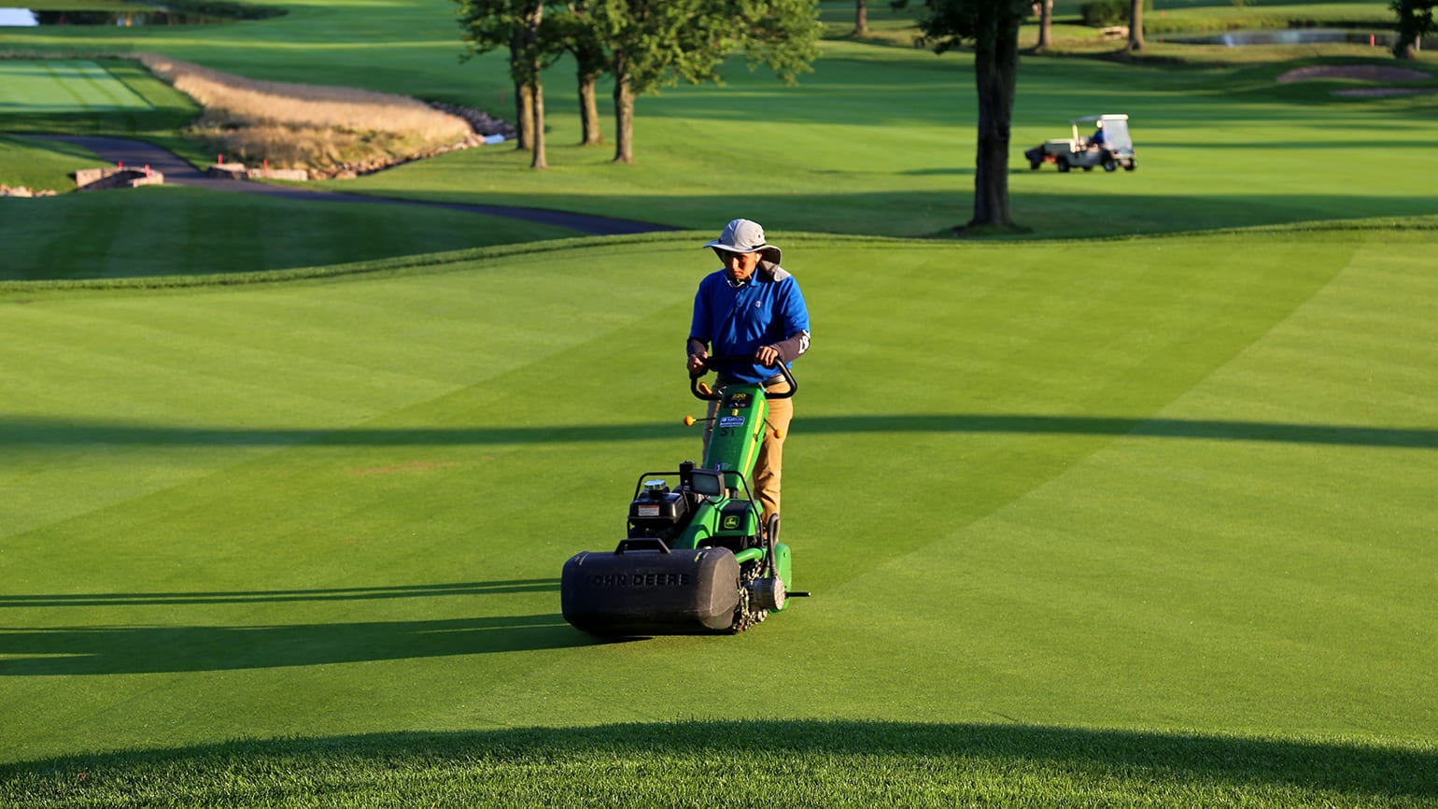
Job Opportunities
Golf Course Management
Many courses being built are open to the public, and management companies often are hired to operate the clubs.
Many municipalities have leased their courses to management companies.
Management companies hire their own employees to operate the clubhouse and to maintain the course.

